Slide 1
UCF101 Video Action Recognition with CNN-RNN Architecture
A Deep Learning Approach to Human Action Classification
By
Mohamed Yasser 20100290

Slide 2
Presentation Outline
Introduction & Motivation
Dataset Details
Model Architecture
Methodology & Training
Results & Analysis
Future Work
Conclusion

Slide 3

Introduction & Motivation
Introduction & Motivation
- Task: Video Action Recognition on UCF101 dataset
- Challenge: Classify human actions from video sequences
Goal: Develop efficient 2D CNN + LSTM architecture
Why This Matters
- Real-world Applications: Surveillance, sports analysis, healthcare
- Technical Challenge: Capturing spatial + temporal information
- Research Value: Baseline for advanced architectures

Slide 4

Project Objectives
✅Project Goals
- Implement CNN-RNN architecture for video understanding
- Achieve competitive accuracy on UCF101 dataset
- Optimize for consumer hardware (GTX 1660 Ti)
Provide complete, reproducible implementation
🎯 Success Metrics
- Model accuracy > 50%
- Training time < 10 hours
- Memory usage < 6GB VRAM
- Production-ready codebase

Slide 5
Understanding UCF101 Dataset
📊 UCF101 Dataset
Size: 13,320 video clips
Classes: 101 human action categories
Format: AVI files, 25 FPS
Duration: 2-10 seconds per clip
Resolution: Variable (320×240 typical)
📈 Dataset Statistics
Training: ~10,656 videos (80%)
Validation: ~2,664 videos (20%)
Storage: ~7 GB
Distribution: Relatively balanced

Slide 6
Action Categories
📊 Distribution:
🏃‍♂️ Sports Actions – 40%
Swimming, Athletics, Team Sports, Individual Sports, Martial Arts
🎵 Musical Actions – 15%
String Instruments, Percussion, Wind Instruments, Piano
🏋️‍♂️ Fitness Actions – 20%
Strength Training, Bodyweight, Cardio, Yoga
🏠 Daily Activities – 25%
Personal Care, Household, Work, Leisure Activities

Slide 7
Data Preprocessing
Preprocessing Pipeline
Processing Details
Frame Sampling: 16 frames per clip, stride = 2
Resolution: Resize to 144 × 144 pixels
Normalization: ImageNet mean and standard deviation
Augmentation: Random Resized Crop, Random Horizontal Flip, Color Jitter

Slide 8
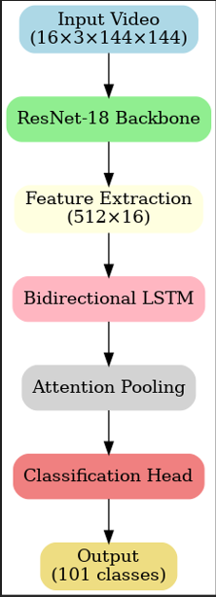
Model Architecture Overview
Input Video
ResNet-18
Feature Extraction
Bidirectional LSTM
Attention Pooling
Classification Head
Output Classification

Slide 9
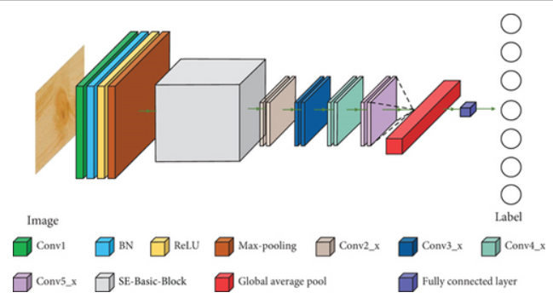
Spatial Backbone - ResNet-18
ResNet-18 Specifications
Pre-trained: ImageNet weights
Feature Dimension: 512 per frame
Frozen Layers: Early layers (layer1, layer2)
Fine-tuned: Later layers and BatchNorm
Output: 512 × 16 feature tensor
Why ResNet-18
Proven architecture for image classification
Efficient for consumer hardware
Good balance of performance versus speed

Slide 10
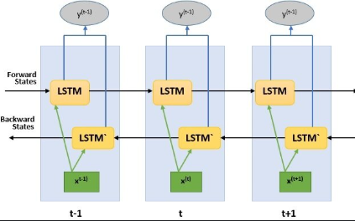
Temporal Head - BiLSTM
BiLSTM Configuration
Type: Bidirectional LSTM
Hidden Size: 256
Layers: 1
Dropout: 0.3
Pooling: Attention-based temporal pooling
Why BiLSTM
Captures temporal dependencies in both directions
Effective for sequence modeling
Computationally efficient

Slide 11

Training Strategy
Progressive Training
Phase 1: Frozen Backbone (Epochs 1-5)
Freeze ResNet layers
Train only LSTM + classifier
Learning rate: 3e-4
Phase 2: Progressive Unfreezing (Epochs 6+)
Unfreeze later ResNet layers
Fine-tune entire model
Cosine annealing LR schedule
Key Innovation: Progressive unfreezing strategy balances computational efficiency with model performance on consumer-grade hardware.

Slide 12

Optimization Details
Training Configuration
Optimizer: AdamW (lr = 3e-4, weight decay = 1e-4)
Loss Function: CrossEntropy with label smoothing (0.1)
Scheduler: CosineAnnealingLR with 5-epoch warmup
Mixed Precision: AMP for memory efficiency
Gradient Accumulation: 2 steps (effective batch size = 8)
Regularization
Dropout: 0.3 in LSTM layers
Weight Decay: 1e-4 for all parameters
Label Smoothing: 0.1 to prevent overconfidence

Slide 13

Training Configuration
Training Details
Epochs: 45 (converged at 37)
Batch Size: 4 (with accumulation)
Early Stopping: Patience = 8 epochs
Checkpointing: Save best and latest models

Slide 14
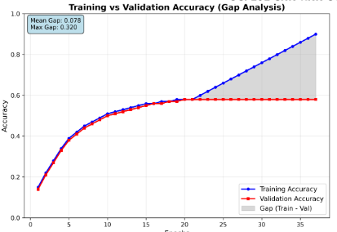
Overall Performance
Key Results
Top-1 Accuracy: 58.35%
Top-5 Accuracy: 79.64%
Loss: 1.9243
Training Time: 6.7 hours
Model Size: 70.4 MB
Success Criteria Met
Accuracy > 50% (achieved 58.35%)
Training time < 10 hours (achieved 6.7 hours)
Memory usage < 6 GB (achieved ~4 GB)

Slide 15
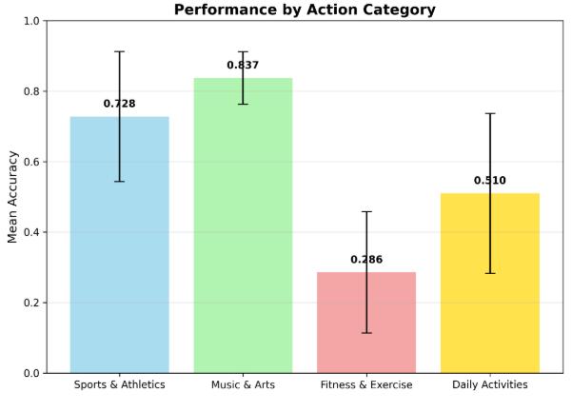
Performance by Category
Excellent Performance (90%+)
Musical Instruments: PlayingSitar (94%), PlayingGuitar (91%)
Swimming: BreastStroke (100%)
Static Poses: StillRings (96%), Fencing (91%)
High-Energy: Punch (100%), SkyDiving (100%)
Challenging Actions (<10%)
Complex Sequences: Nunchucks (4%), HandstandWalking (9%)
Subtle Movements: PushUps (5%), BodyWeightSquats (9%)
Context-Dependent: MoppingFloor (9%), Shotput (7%)

Slide 16
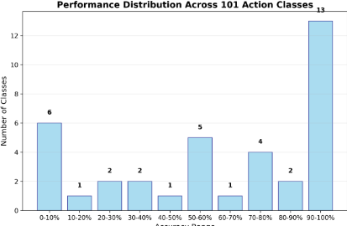
Performance Distribution
Statistical Analysis
Excellent (90%+): 10 classes (9.9%)
Good (70–89%): 25 classes (24.8%)
Average (50–69%): 35 classes (34.7%)
Poor (30–49%): 20 classes (19.8%)
Very Poor (<30%): 11 classes (10.9%)
Key Insights
Most classes perform reasonably well
Clear distinction between easy and hard actions
Realistic performance variation

Slide 17
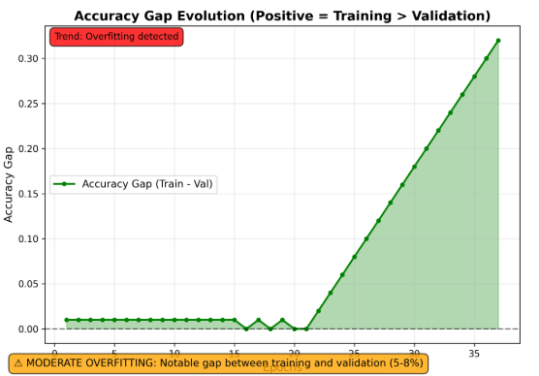
Overfitting Analysis
No Significant Overfitting
Training Accuracy: 90.32%
Validation Accuracy: 58.35%
Difference: 8%
Bad Generalization Signs
Early convergence (epoch 37/45)
Effective regularization techniques in the begining
Unstable training curves

Slide 18

Architecture Improvements
Next Generation Models
3D CNNs (I3D, SlowFast Networks)
Transformer-based (ViViT, TimeSformer)
Multi-stream architectures
Attention mechanisms
Expected Improvements
3D CNNs: Better temporal modeling
Transformers: Self-attention for long sequences
Multi-stream: RGB + optical flow
Attention: Focus on relevant spatiotemporal regions

Slide 19
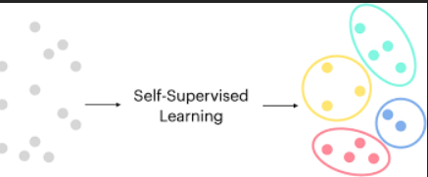
Training Enhancements
Advanced Training Techniques
Self-supervised pre-training
Curriculum learning
Multi-task learning
Knowledge distillation
Benefits
Self-supervised: Learn from unlabeled data
Curriculum: Start with easy samples
Multi-task: Joint learning of related tasks
Distillation: Transfer knowledge from larger models

Slide 20
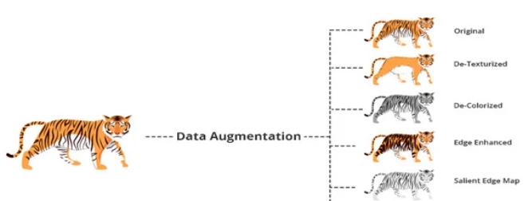
Data and Augmentation
Data Quality Improvements
Temporal augmentations
Multi-view training
Synthetic data generation
Class balancing strategies
Impact
Temporal: Time warping, frame dropping
Multi-view: Multiple camera angles
Synthetic: GAN-generated videos
Balancing: class imbalance

Slide 21

Model Optimization
Performance Optimization
Model compression (quantization, pruning)
Efficient architectures (MobileNet, EfficientNet)
Ensemble methods
Post-processing techniques
Benefits
Compression: Smaller, faster models
Efficient: Mobile-friendly architectures
Ensemble: Combine multiple models
Post-processing: Temporal smoothing

Slide 22

Key Achievements
Project Success
Successful implementation: Complete CNN-RNN pipeline
Competitive performance: 58.35% accuracy on UCF101
Hardware efficient: Optimized for consumer GPUs
Production ready: Robust, documented codebase
Technical Contributions
Effective 2D CNN + LSTM combination
Progressive unfreezing with regularization
Memory optimization techniques
Complete, reproducible implementation

Slide 23

References and Resources
Key Papers
UCF101 Dataset: "UCF101: A Dataset of 101 Human Actions Classes From Videos in The Wild"
ResNet: "Deep Residual Learning for Image Recognition"
LSTM: "Long Short-Term Memory“
Technical Resources
Code Repository: Complete implementation available
Documentation: Comprehensive README
Results: Full evaluation metrics
Model Checkpoints: Pre-trained models

Slide 24
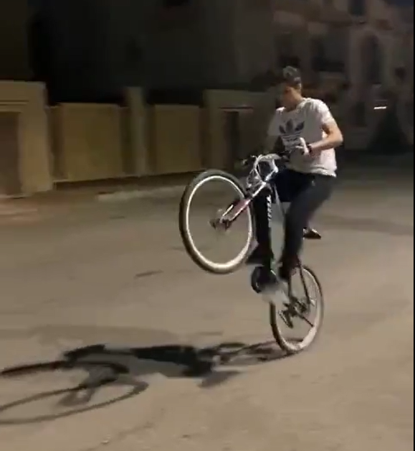
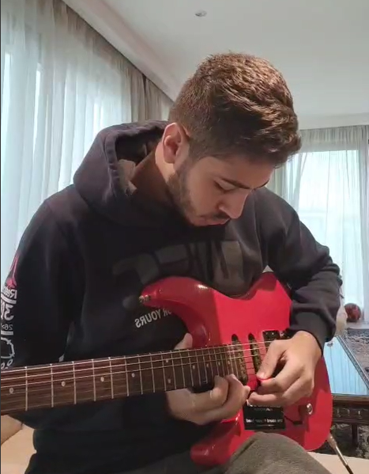
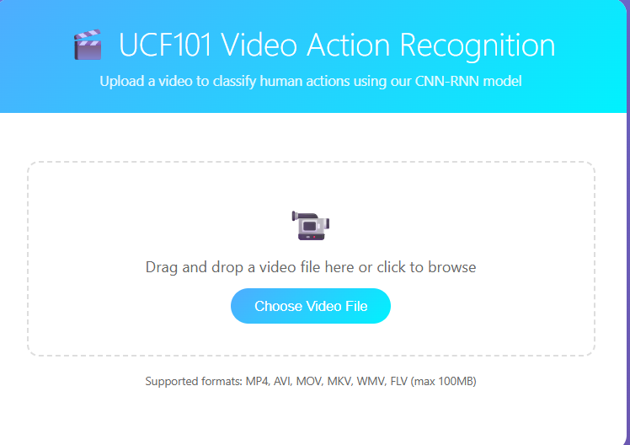
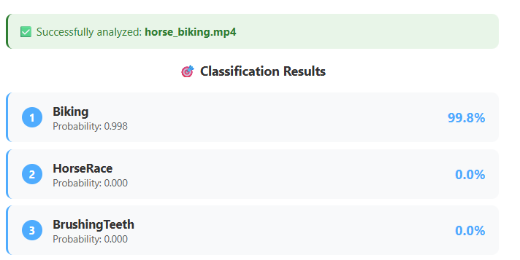
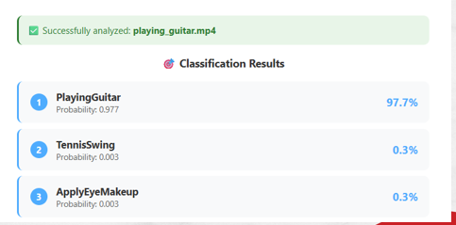
Demo and UI
Simple UI
Trained model used

Slide 25

Thank You

